Slide 1
Final Internship Checkpoint
Opportunity Intelligence – Advanced Analytics Team 2025
Janardhan Kuruva

Slide 2
Agenda
1 | Welcome
2 | Internship Goals and Objectives
3 | Weekly Progress Timeline
4 | Projects Overview
5 | Web Crawling & Automation Process
6 | Next Steps

Slide 3
Internship Goals and Objectives:
Get hands on experience on real-world application of academic concepts
Professional Development Goals:
Gain hands-on experience in healthcare policy and regulatory compliance technology.
Develop technical skills in data extraction, automation, and AI/ML applications.
Contribute meaningfully to solving real business challenges faced by the legal team.
Strengthen teamwork through projects and regular interactions.
Seek continuous feedback from supervisors and peers to identify strengths and areas for improvement.
Develop professional relationships with team members with the OI team and other departments.

Slide 4
Internship Progress Timeline:
Task
​Orientation & Training
​Project Scope
Research
​Web Crawling
Stakeholder Review
Documentation
Deployment
Data Analysis
Week 1 Jun 30th | Week 2 July 7th | Week 3 July 14^{h} | Week 4 July 21st | Week 5 July 28th | Week 6 Aug 4th | Week 7 Aug 11th | Week 8 Aug 18th | Week 9 Aug 25th | Week 10 Sept 1st | Week 11 Sept 8th | Week 12 Sept 15th | Week 13 Sept 22nd | Week 14 Sept 29th | Week 15 Oct 6th | Week 16 Oct 13th | Week 16 Oct 17th
​ | ​ | ​ | ​ | ​ | ​
​ | ​ | ​ | ​ | ​ | ​
 |  |  | ​ | ​ | ​
​ | ​ | ​ | ​ | ​ | ​
​ | ​ | ​ | ​ | ​ | ​
Legal IQ
OOS

Slide 5
Legal IQ
Optimizing Legal review process of Healthcare Policy changes

Slide 6
Transforming Regulatory Monitoring: From Manual Processes to AI Automation
Problem Statement
Manual monitoring of multiple federal and state websites for legislative updates
Legal team extracts and enters data into Excel spreadsheets
Inconsistent formats and update schedules create complexity
Difficult to quickly identify regulatory impacts on Cotiviti’s solutions
Proposed Solution
Automate extraction of legislative data into a centralized Regulatory Tracker
Use AI chatbot for quick searches and proactive alerts
Standardize data capture across all states and territories to improve efficiency and reliability
Notes:
5

Slide 7
Project Team
Team Members | Role
Krista Baisch; Ashley Harms; Jessica Joseph | Users, Legal
Janardhan Kuruva | Lead Analyst (Intern), OI
Pranay Neema | Lead and PM, OI
Jonathan Edwards | VP, OI
Project Phases
P-I
P-II
P-III
Automate Data Collection (Web Crawling): 51 states + CMS + OIG legislative sites
Deploy the solution in production to run it every month
AI/ML solution: - determining impact on the Cotiviti solutions - generate impact insights - chatbot to quickly search the insights
Notes:
Project Phases
Project Scope
Phase I
Automate Data Collection from 51 States Legislative Websites
Phase II
Automate Data Collection from CMS and OIG Websites
Phase III
Predict impact on Cotiviti Solutions by changes in legislation
Phase IV
Generate prescriptive insights to help understand the impact & proposed mitigation strategy

Slide 8
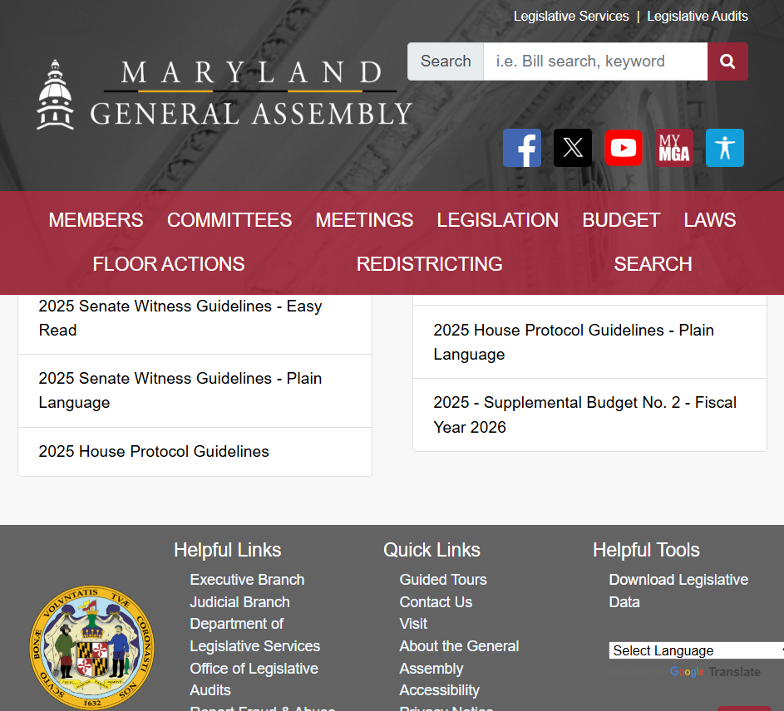
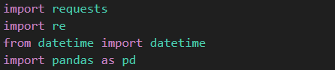
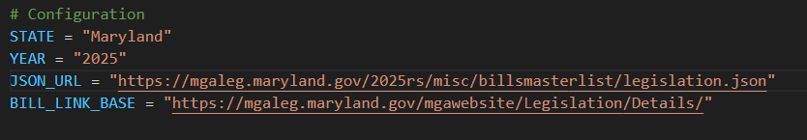
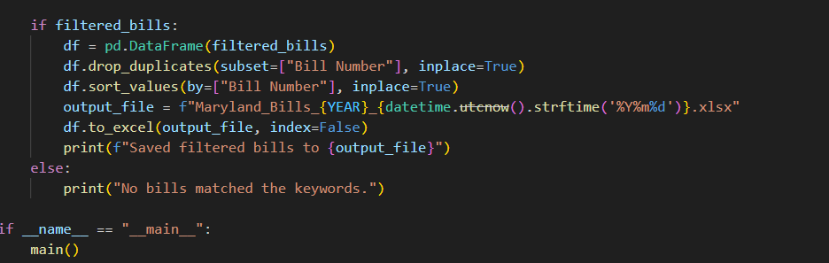
Direct JSON/CSV downloads - Maryland

Slide 9
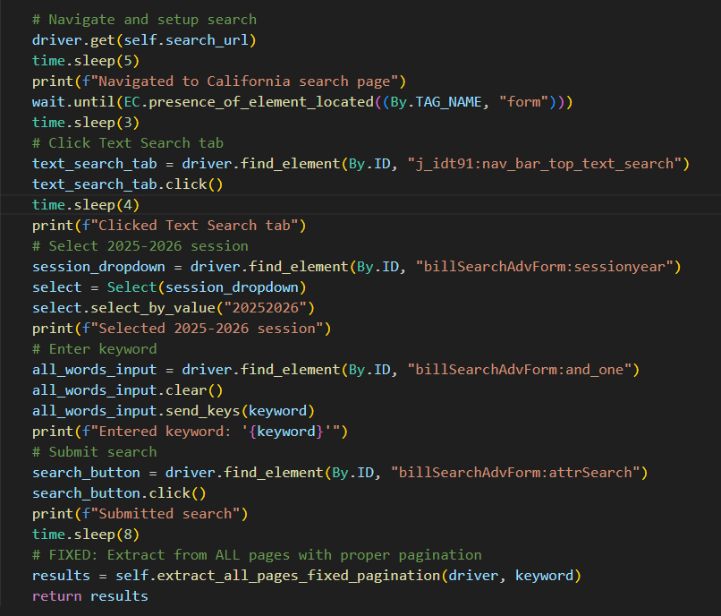
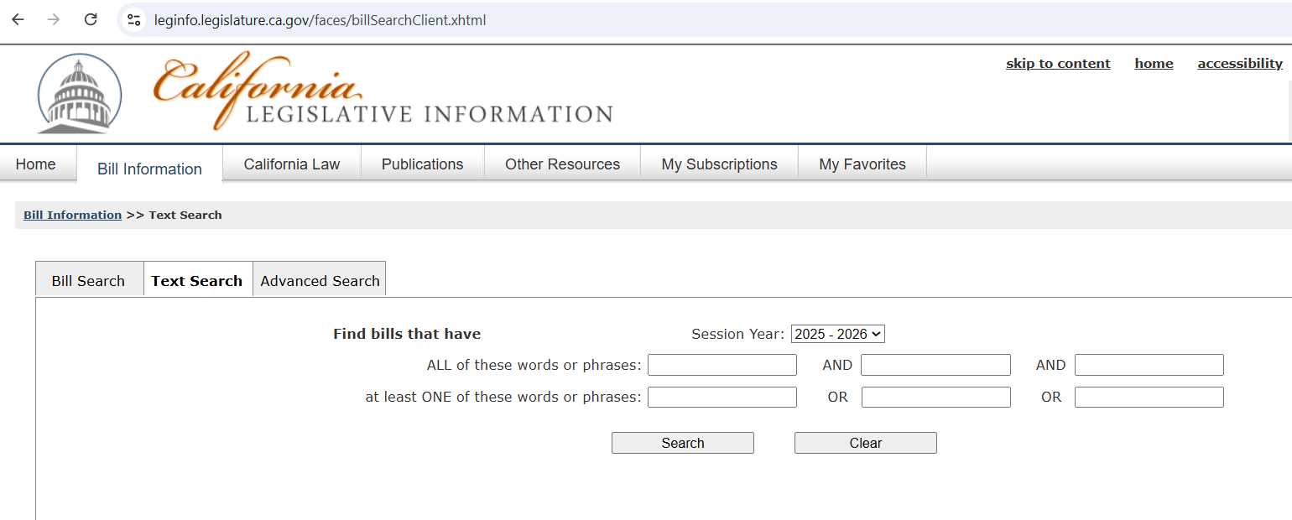
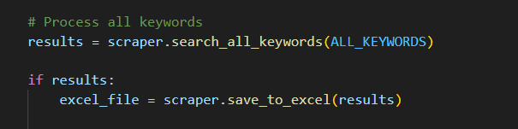
Selenium Automation Approach - California

Slide 10




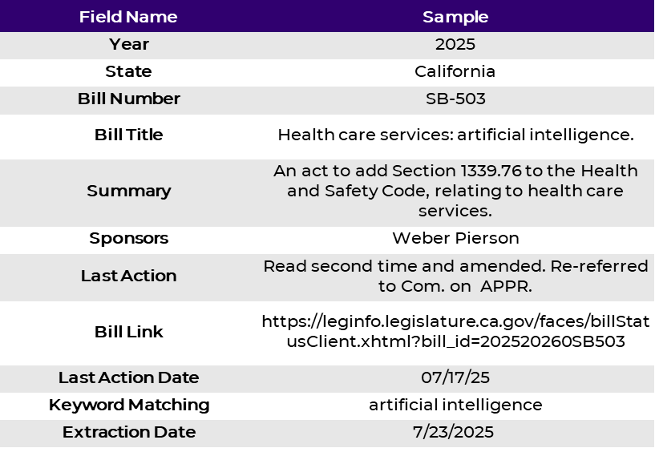
Web crawling workflow
Visit and understand the website structure for a state
Decide the optimum approach to scrape data from the website
Fetch the relevant datapoints of laws based on keywords
Validates and Store the datapoints in a structured format
Web link:
Colorado General Assembly
Alaska State Legislature California State Legislature
Georgia General Assembly
Kansas Legislature
Direct JSON/CSV downloads
HTML parsing
Selenium Automation
Others
Artificial intelligence
Automated decision making
Automate decision support
Clean claims
Clinical decision support
Coordination of benefits
Health carriers and payment
Medical necessity review
Payment and health carriers
Preauthorization
Prior authorization
Prompt pay
Prompt payment
Utilization review
Utilization management
Look-back period
Claim edits
Fraud, waste, and abuse

Slide 11









Streamlined Automated Production Pipeline
OpenShift
Jenkins
Cron JOB
Docker Container
Scheduler
Relevant Bills
Inbox alert
Websites
Scrap
Filter
Store
Code runs first Friday of each month, pulling relevant bills from legislative websites and storing on Share point and Hadoop, along with an email notification to the users

Slide 12
Value Proposition
Process Efficiency
Time savings achieved through automation
0-240 0-30
Before (mins) After (mins)
Development Progress
52 states, CMS and OIG legislation pull completed;
Implementation Progress
Completed 49 of 52 states, CMS and OIG legislation solution implementation;
87.5%
100%
95%
Notes:
Progress on

Slide 13
Out of Sequence (OOS)
Sizing Analysis
HCSC Sep 2025 & RVA – All player

Slide 14








Ideal Scenario
C O T I V I T I
May 5th
Claim 1
Claim 2
Bundles them together &
submit the claim with
proper coding guidelines
Hospital
Payer
July 5th
Adjudicate appropriately
Out of Sequence
C O T I V I T I
Claim 1
May 5th
July 5th
Payer
Claim 1
Claim 2
Claim 2
C O T I V I T I
Hospital
Payer
July 7th
OOS problem
Time Gap
Incorrect Payments
Lost Savings
Operational Burden

Slide 15
Objective
Understanding & Quantify
Analyze OOS claims impact
Estimate business value ($)
Assess Feasibility
Operational & Financial viability
Support go/no-go decision
Future Direction
Explore predictive analytics for proactive detection
✅
🤖
Data Sources
Platform | Date | Client/s | OOS Claim Count | Estimated Savings | Key Insight
CVP | Sep’25 | HCSC | 0.06M | $7.4M | ~31% of the OOS edits identified are in Day 1 – 3 constitute $1M Estimated Savings
ICMS Production RVA | Sep’25 | All PPM ICMS | 8.7M | $960M | ~12% of the OOS edits identified are in Day 1 – 3 constitute $95M Estimated Savings
Notes:
Estimate how much savings are lost due to OOS claims.
Measure volume and dollar distribution across time buckets, rules, plans, products, and providers
Recommend OSS claim hold windows (e.g., pend for 1–2 days).
Explore Predictive Modeling (future phase)
• Develop ML models to predict which claims are likely to be OOS.

Slide 16
Pending claims processing for 1-3 days can results in an ~$95M in estimated savings
Threshold :
Covering ~ 12% edits volume with 10% Estimated savings
Est. Savings Amount
Edits

Slide 17
Next Steps
Legal IQ
Continue monitoring the solution in production
Develop a Generative AI chatbot that interacts with legislative websites and answers questions based on its content
Out Of Sequence
Continue performing OOS data analysis to help estimate the potential sizing
AI/ML model to predict OOS claims proactively to help reduce lost savings

Slide 18



Lessons Learned:
Application of academic knowledge
Collaboration
Adaptability & Continuous Learning
Feedback:
Centralized Access and Tools Checklist for Interns

Slide 19


Slide 21
What is an OOS Claim
A claim for a comprehensive service (e.g., venipuncture) that arrives and is processed before a later, another comprehensive service claim (e.g., lab panel) with the same date of service.
The system pays the first claim before seeing the bundled/global service that should override or encompass it.
Problem
When the comprehensive claim arrives later, the system has already paid the another claim.
Results in incorrect payments, duplicate reimbursements, and lost savings.
Manual recovery efforts increase administrative costs and delay true claim adjudication.

Slide 22
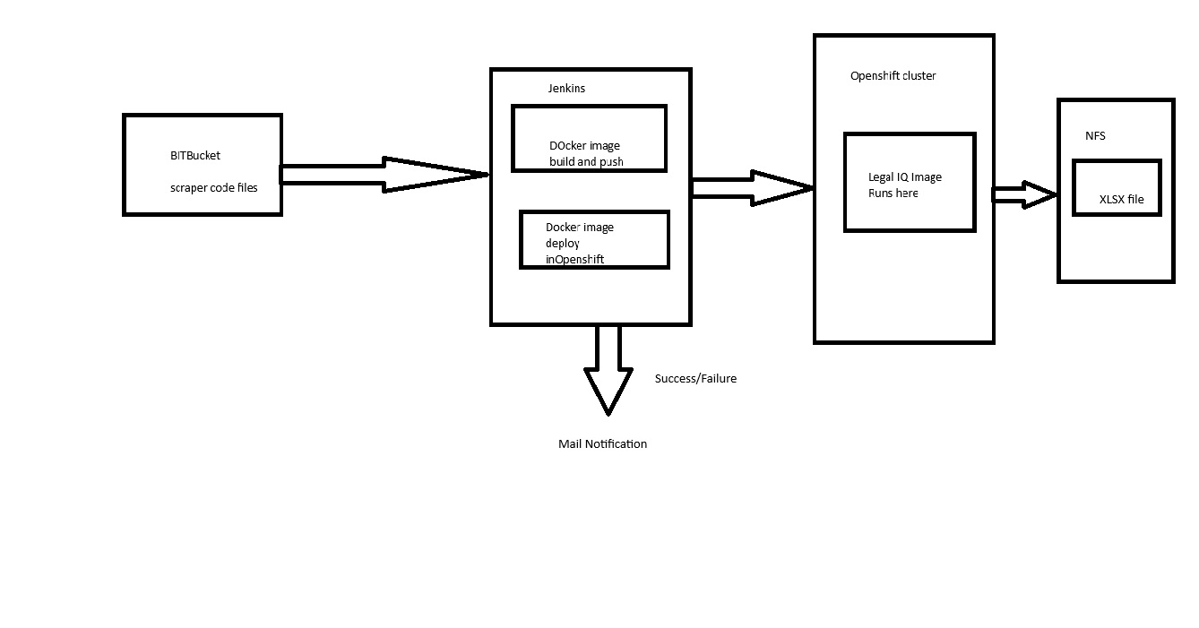

Slide 23
Streamlined Automated Production Pipeline
Docker Container
Scheduler
Relevant Bills
Inbox alert
Websites
Scrap
Filter
Store
Code runs first Friday of each month, pulling relevant bills from legislative websites and storing on Share point and Hadoop, along with an email notification to the users

Slide 25
HCSC – CVP

Slide 26
HCSC OOS Savings is concentrated to CV, Professional, and TX/IL state
CE
CV
Fac
Prof
>92% OOS claims of HCSC plan are from TX and IL states constitute to 90% of the Estimated Savings, ~$7M

Slide 27
Top 5 Rule Categories contribute to ~80% of Estimated Savings $6M
5 Rule categories contribute to 80% of Estimated Savings
Total Rule Categories: 37

Slide 28
Pending claims processing for 5 days cover 41% claim volume with an Estimated Savings of ~$1.5 M (20%)
Threshold 2: Covering > 20% Estimated Savings
Threshold 1:
Covering ~31% claim volume with 14% Estimated savings
Estimated Savings Amount
Claim Count

Slide 29
All PPM Clients RVA - ICMS

Slide 30
~$1B (17%) is OOS Savings concentrated in Professional & Outpatient claim type
Not OSS
OSS
Notes:
Make separate

Slide 31
Top 10 Clients contributing $63.5M Savings from OOS 1-5 Days
Top 10 DP Keys contributing to $66M Savings from OOS 1-5 Days
Total Clients: 302
Total Unique DP Keys: 1012
31

Slide 33


Web crawling workflow
1
Decide the optimum approach to scrape data from the website
3
Validates and Store the datapoints in a structured format
Visit and understand the website structure for a state
2
Fetch the relevant datapoints of laws based on keywords
4

Slide 34







Progress
83.33 % time saved
Challenges
Dynamic Content Loading
Inconsistent Data Formats
Anti-Bot Detection
Challenges
Se
Use Selenium
Convert using standard logic
Use Headless Browsers
Solution

Slide 35
Approach Overview
Multiple approaches for legislative websites
Simple HTTP requests to download structured data files
requests library + Pandas
Performance: Fastest execution
Static HTML parsing with BeautifulSoup for bill-by-bill extraction
requests + BeautifulSoup + custom parsing logic
Performance: Moderate
Full browser automation with Selenium for dynamic content interaction
Selenium WebDriver + BeautifulSoup + retry mechanisms
Performance: Slow
Direct JSON/CSV downloads
HTML parsing
Selenium Automation

Slide 36
What Is an Out-of-Sequence Claim? A claim for a less comprehensive service (e.g., venipuncture) that arrives and is processed before a later, more comprehensive service claim (e.g., lab panel) with the same date of service. The system pays the first claim before seeing the bundled/global service that should override or encompass it.
The Problem Statement When the comprehensive claim arrives later, the system has already paid the smaller claim. Results in incorrect payments, duplicate reimbursements, and lost savings. Manual recovery efforts increase administrative costs and delay true claim adjudication.
Example May 5, 2025: Provider submits CPT 36415 (venipuncture) → System pays $X. Later (hours/days): Provider submits CPT 80050 (general health panel) for same date → NCCI bundles 36415 into 80050 → 36415 should have been denied. Outcome: Overpayment on 36415 that must now be identified and recouped.

Slide 37
Data Summary
Field Name | Sample
Year | 2025
State | California
Bill Number | SB-503
Bill Title | Health care services: artificial intelligence.
Summary | An act to add Section 1339.76 to the Health and Safety Code, relating to health care services.
Sponsors | Weber Pierson
Last Action | Read second time and amended. Re-referred to Com. on APPR.
Bill Link | https://leginfo.legislature.ca.gov/faces/billStatusClient.xhtml?bill_id=202520260SB503
Last Action Date | 07/17/25
Keyword Matching | artificial intelligence
Extraction Date | 7/23/2025
Keywords to look for :
Artificial intelligence
Automated decision making
Automate decision support
Clean claims
Clinical decision support
Coordination of benefits
Health carriers and payment
Medical necessity review
Payment and health carriers
Preauthorization
Prior authorization
Prompt pay
Prompt payment
Utilization review
Utilization management

Slide 38
Project Life Cycle
Manual Runtime
Runtime
2 Hours
2 minutes to 15 minutes
1

Slide 39
Progress

Slide 40
Project Life Cycle
1
2
3
4
5
Discovery and Requirements Gathering
Prototyping
Prototype Evaluation
Expand Data Collection
Model Development

Slide 41
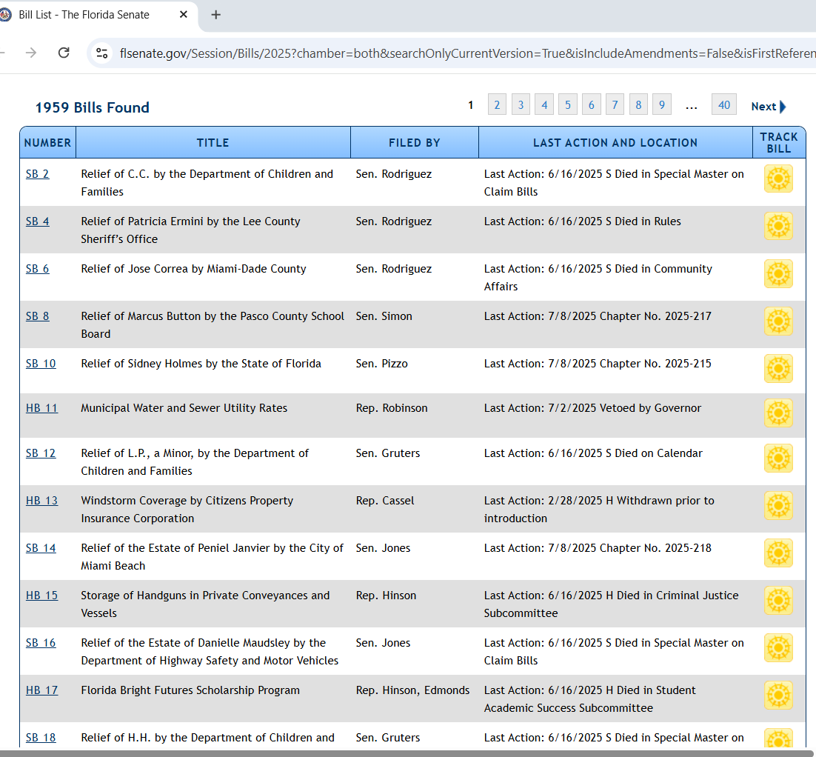
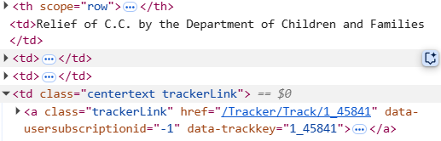
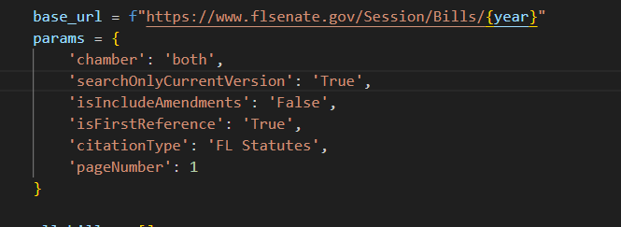
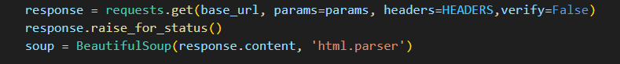
HTML Parsing - Florida

Slide 43
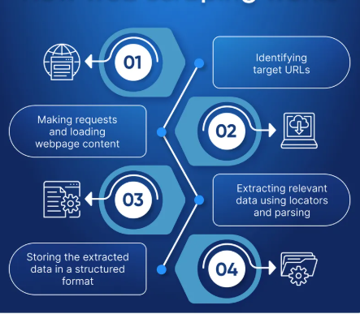



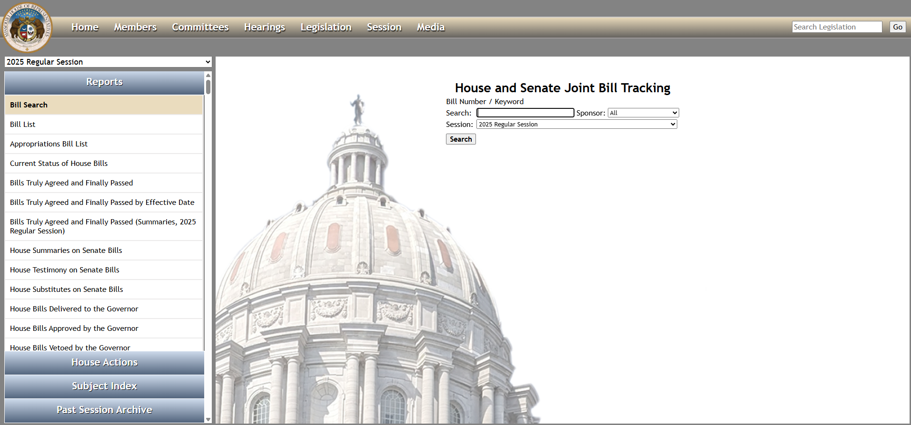
Workflow
Visit and understand the website structure for a state
Select the best approach

Slide 44

1. Selenium Automation 2. HTML parsing with BeautifulSoup
3. Direct JSON/CSV downloads

